Slide 1
Car accounting self service Overview
Scott Churchill
ACACSO
Albuquerque ,NM
November 12, 2015

Slide 2
What is Car Accounting Self service (cass)?
Single car event query
Liability Acceptance Message (LAM) creation
Other reports

Slide 3
Cass Event query
Single car event search
90 day date range
2 years of event data
Industry view of all records
Access into Event Repository Data

Slide 4
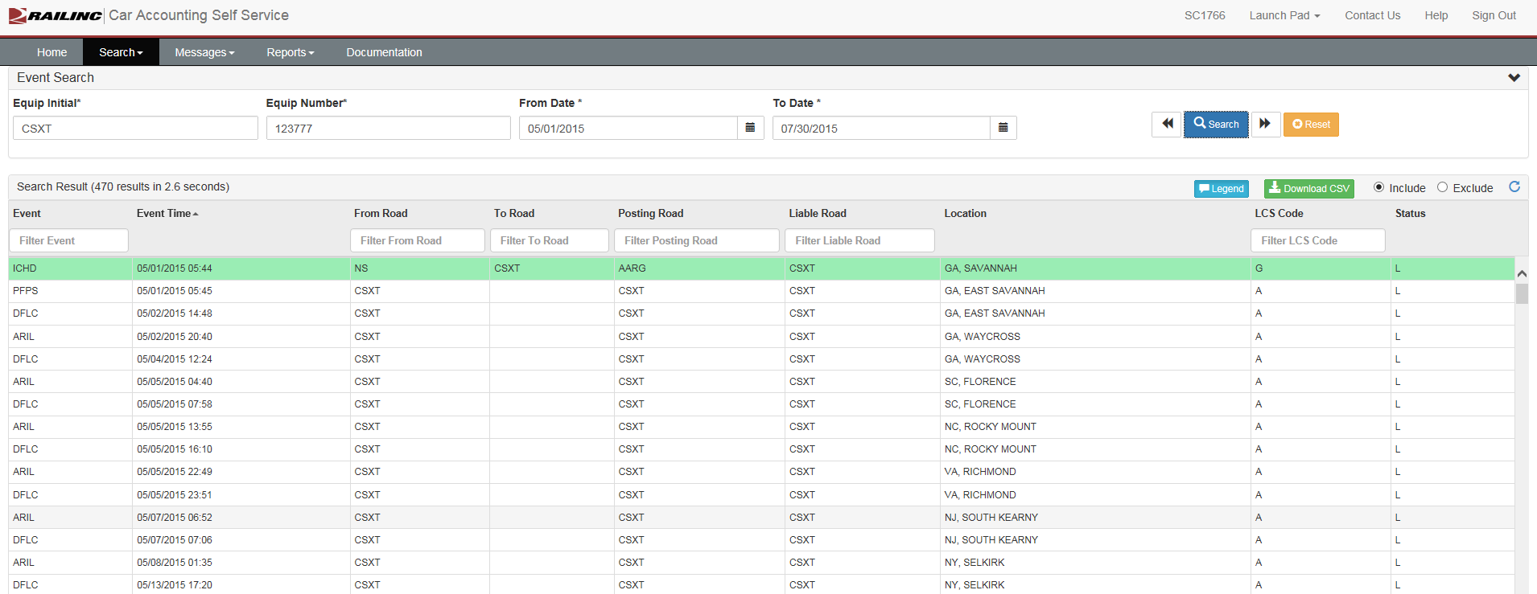
Navigating cass - event search

Slide 5
NAVIGATING CASS – QUICK SEARCH

Slide 6
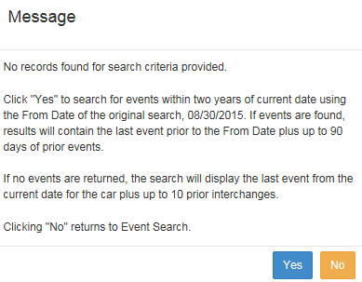
NAVIGATING CASS – EVENTS NOT FOUND

Slide 7
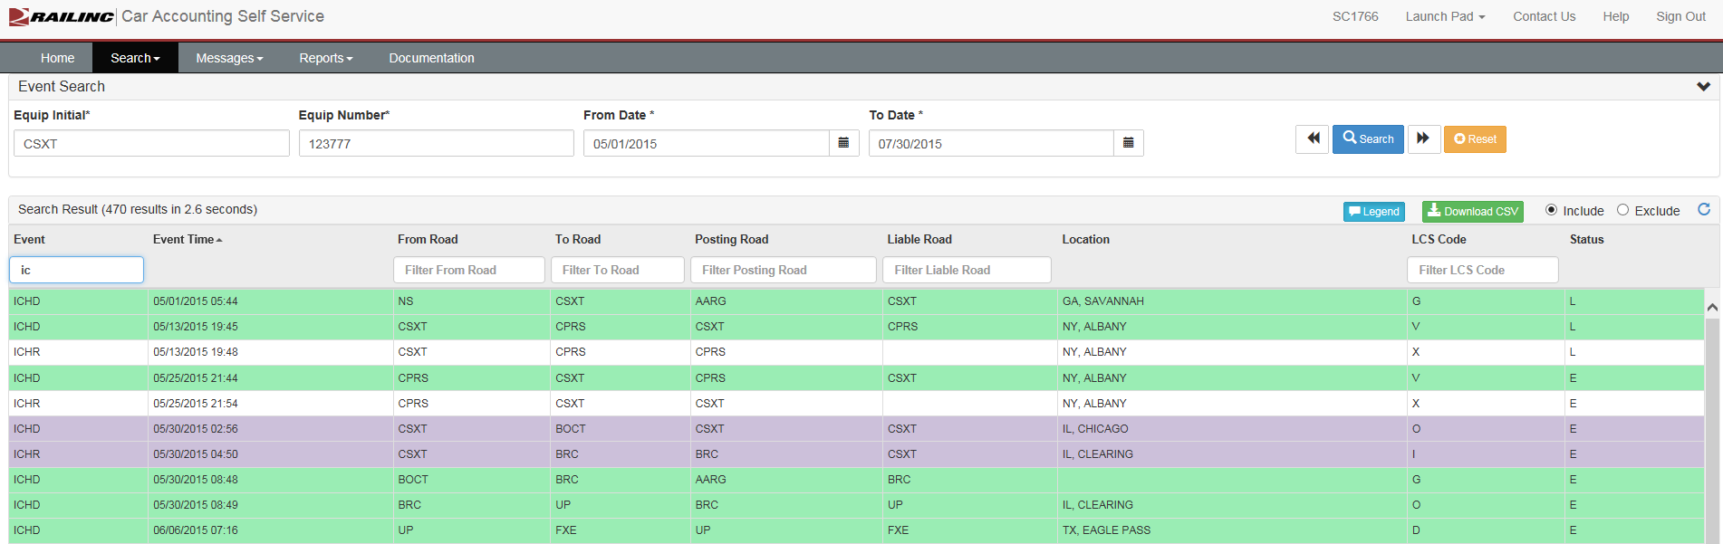
Navigating cass – filters

Slide 8
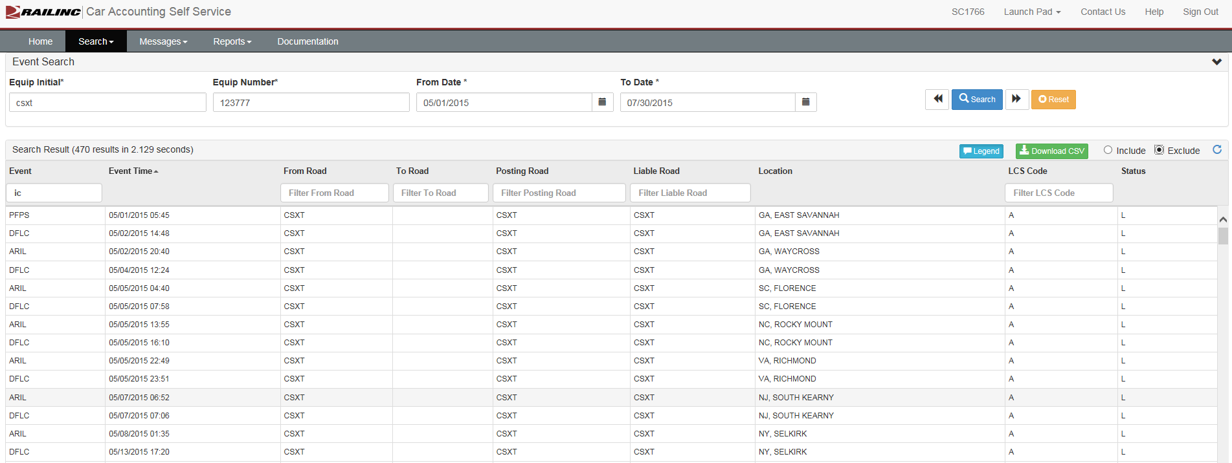
Navigating cass – filters

Slide 9
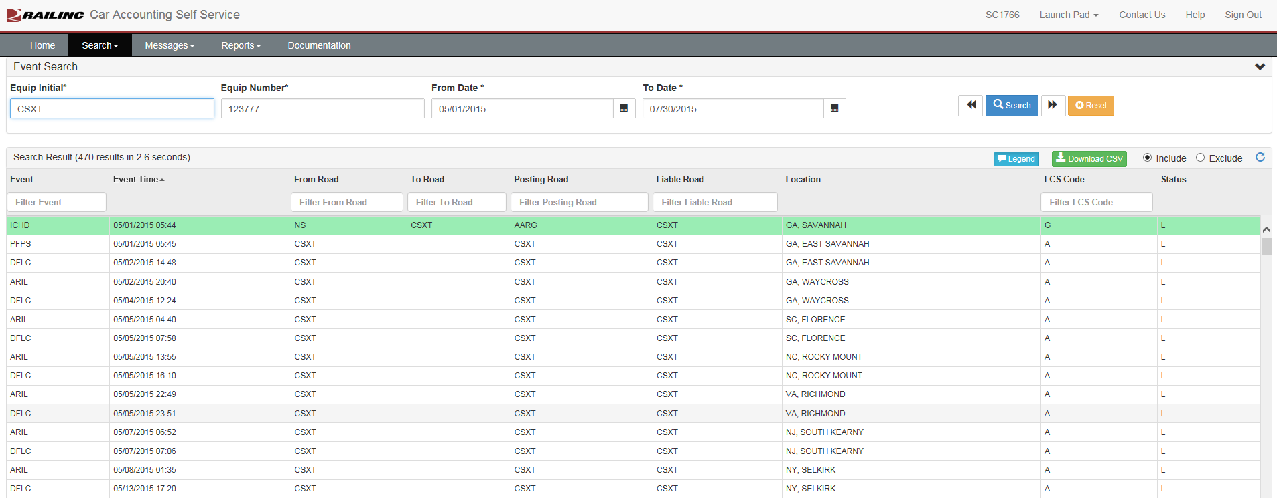
Navigating cass – download csv

Slide 10
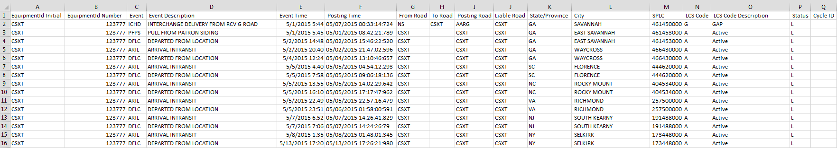
Navigating cass – download csv

Slide 11
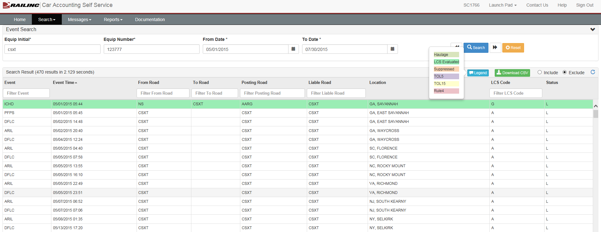
Navigating cass – legend

Slide 12
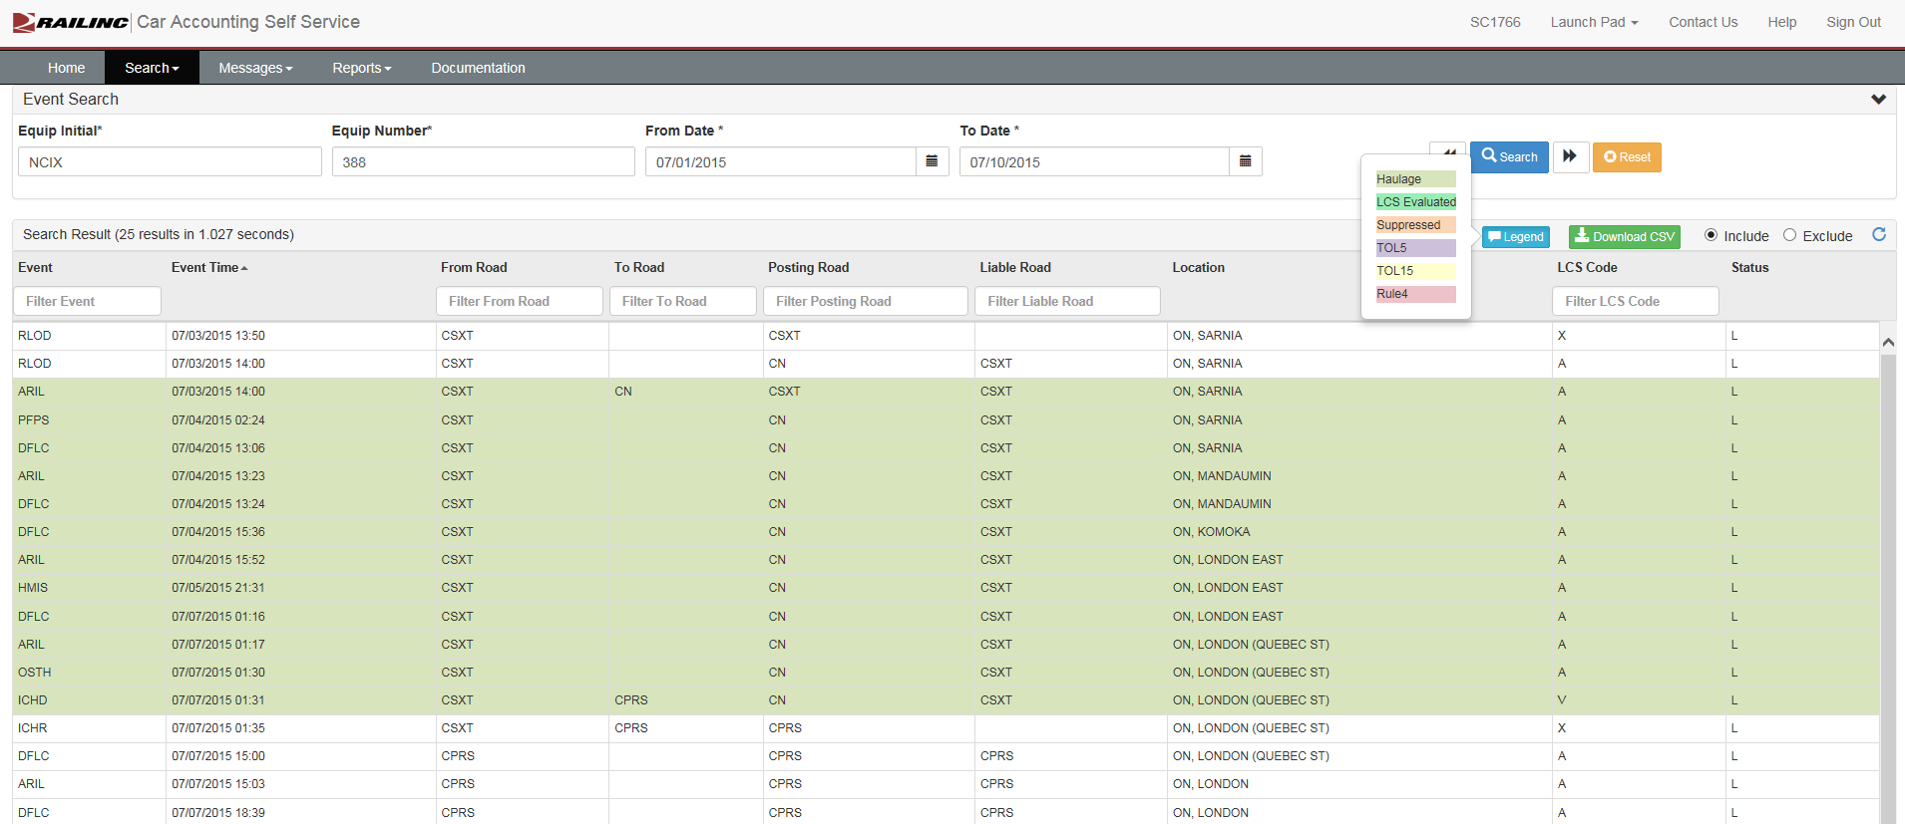
Cass overview – haulage

Slide 13
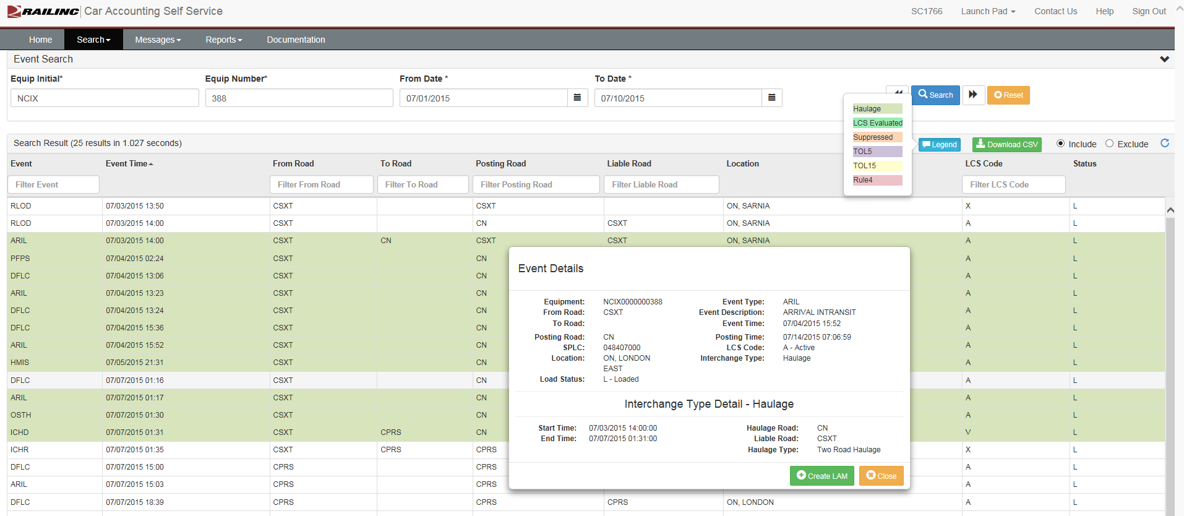
CASS OVERVIEW – HAULAGE

Slide 14
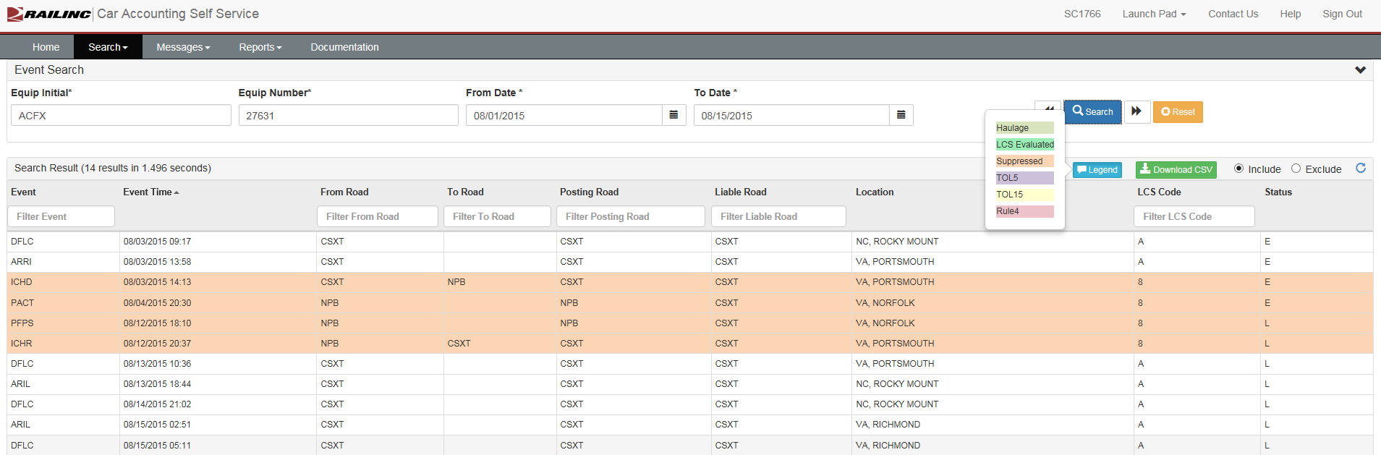
CASS OVERVIEW – SUPPRESSION

Slide 15
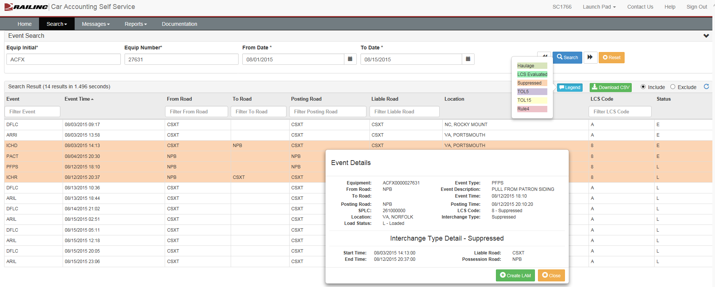
CASS OVERVIEW - SUPPRESSION

Slide 16
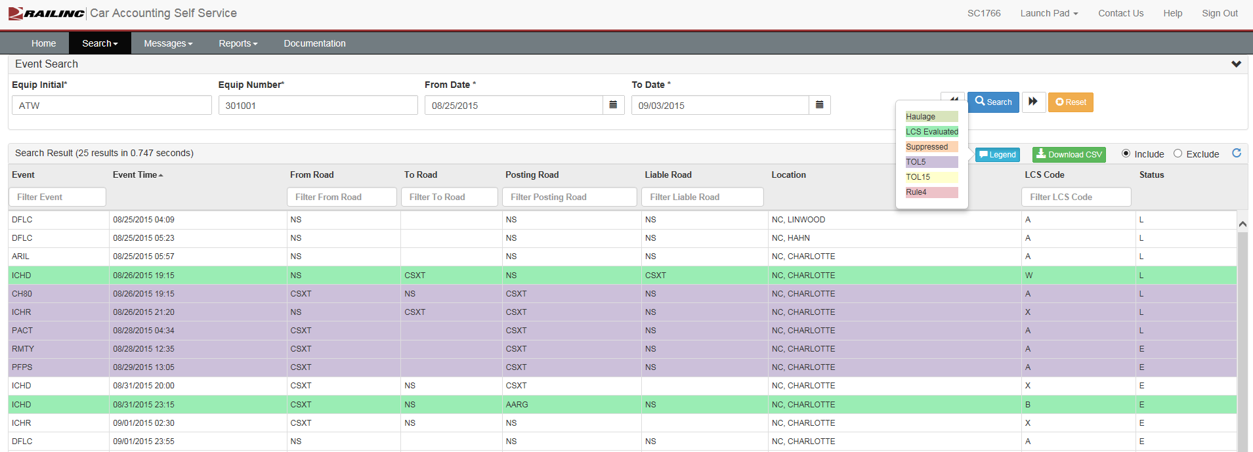
CASS OVERVIEW – RULE 5 TRANSFER OF LIABILITY (TOL)

Slide 17
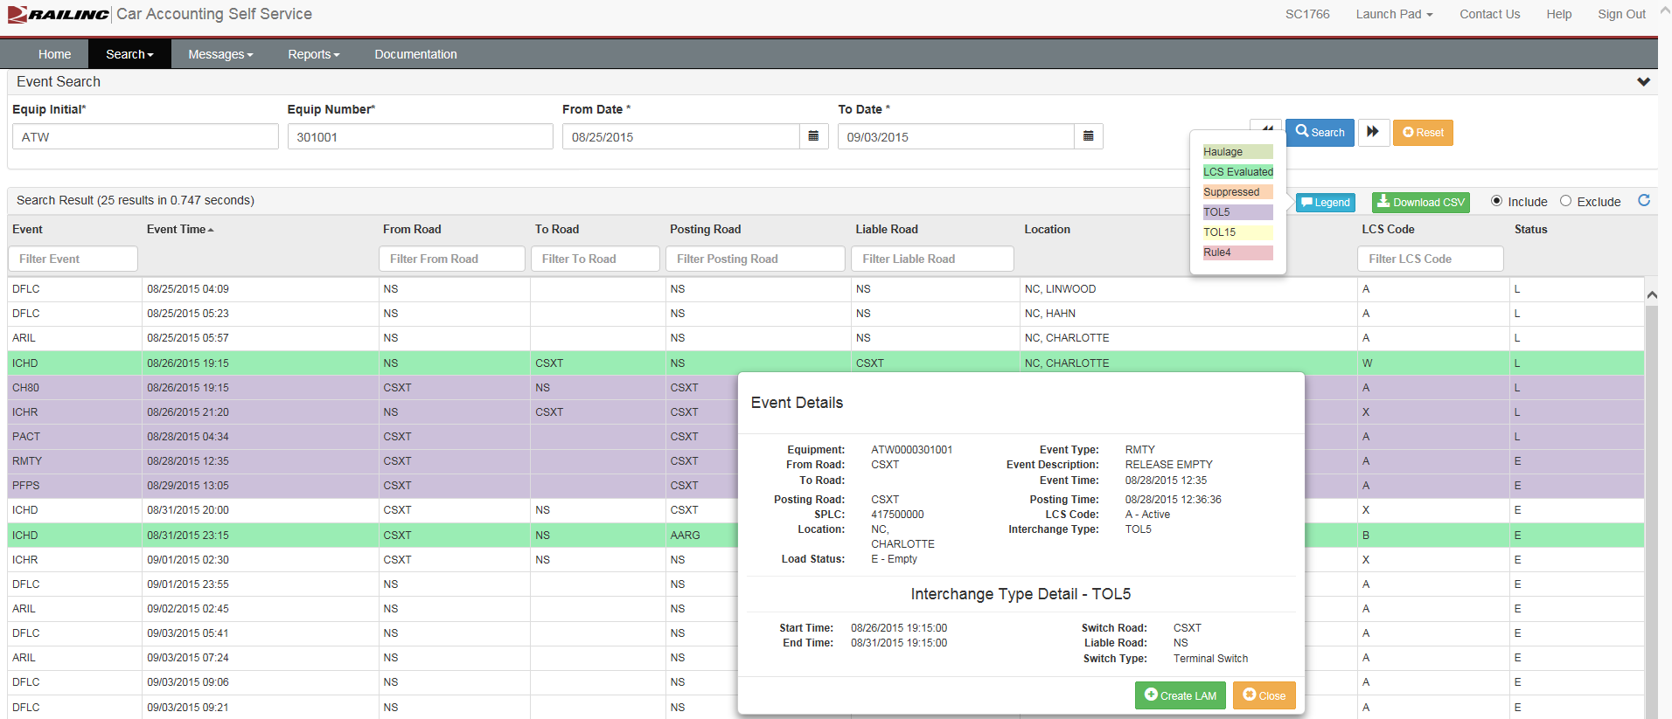
CASS OVERVIEW – RULE 5 TOL

Slide 18
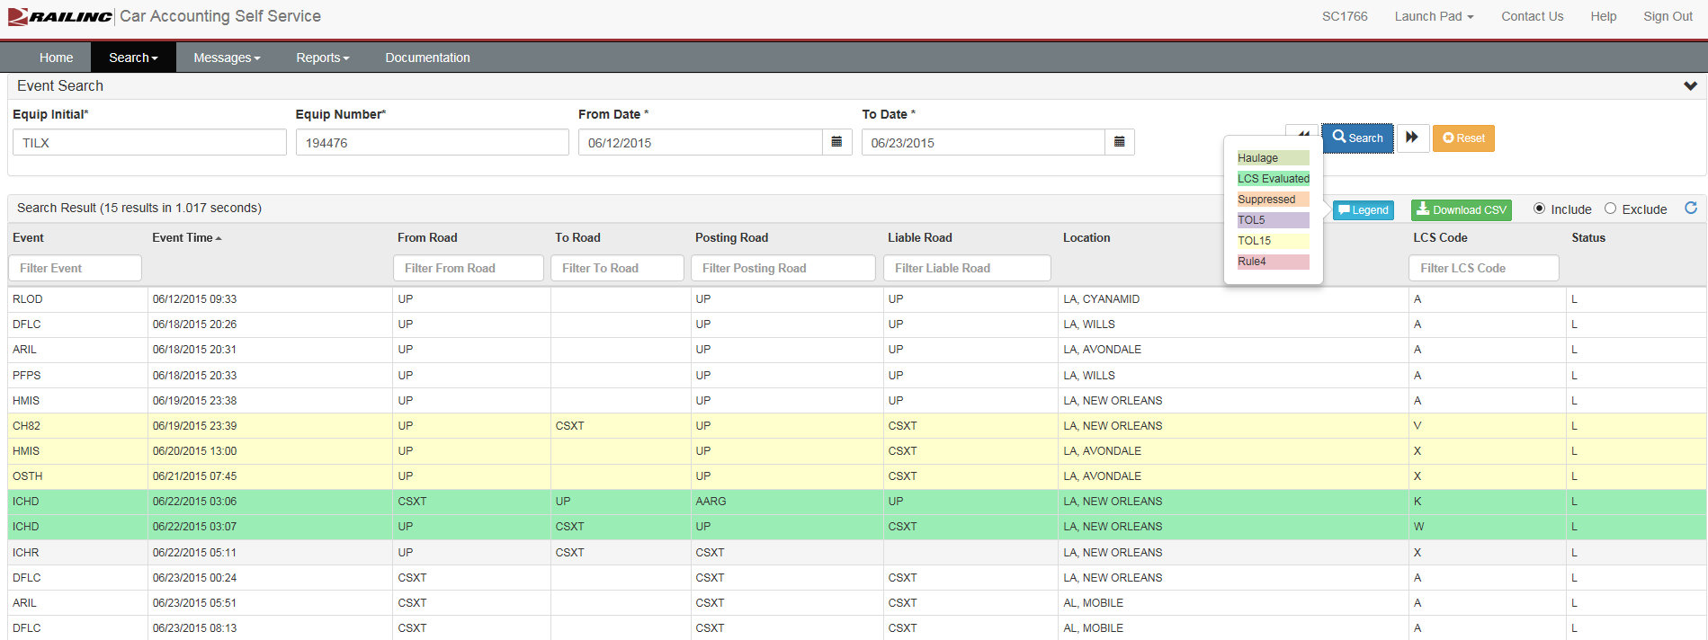
CASS OVERVIEW – RULE 15 TOL

Slide 19
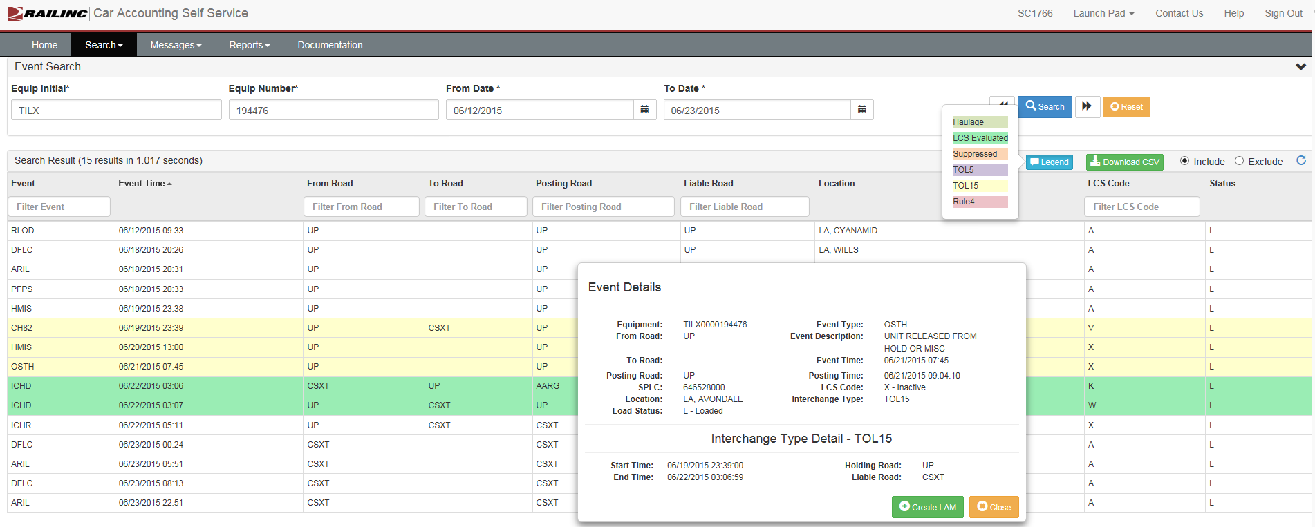
CASS OVERVIEW – RULE 15 TOL

Slide 20
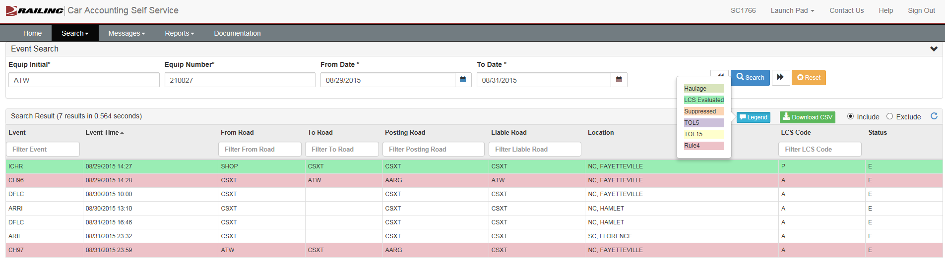
CASS OVERVIEW – RULE 4 TOL

Slide 21
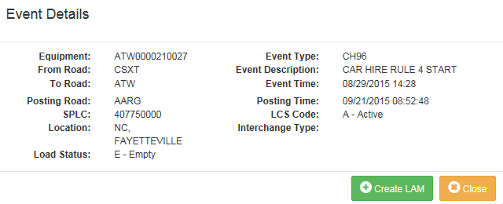
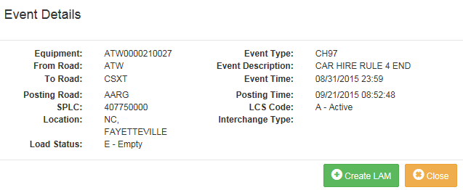
CASS OVERVIEW – RULE 4 TOL

Slide 22
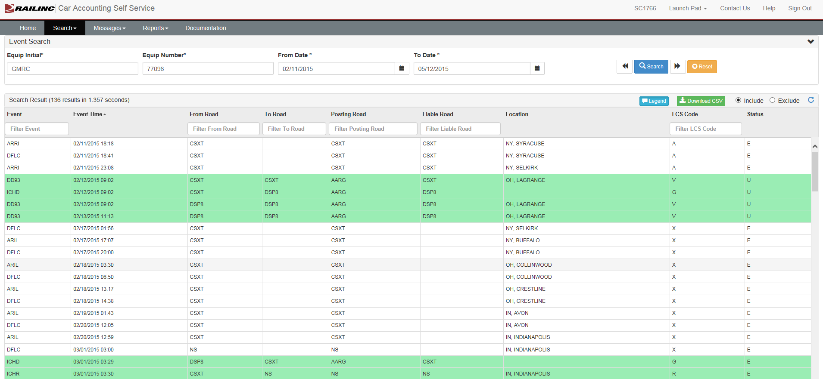
CASS OVERVIEW – DAMAGED AND DEFECTIVE CAR TRACKING (DDCT) / RULE 8

Slide 23
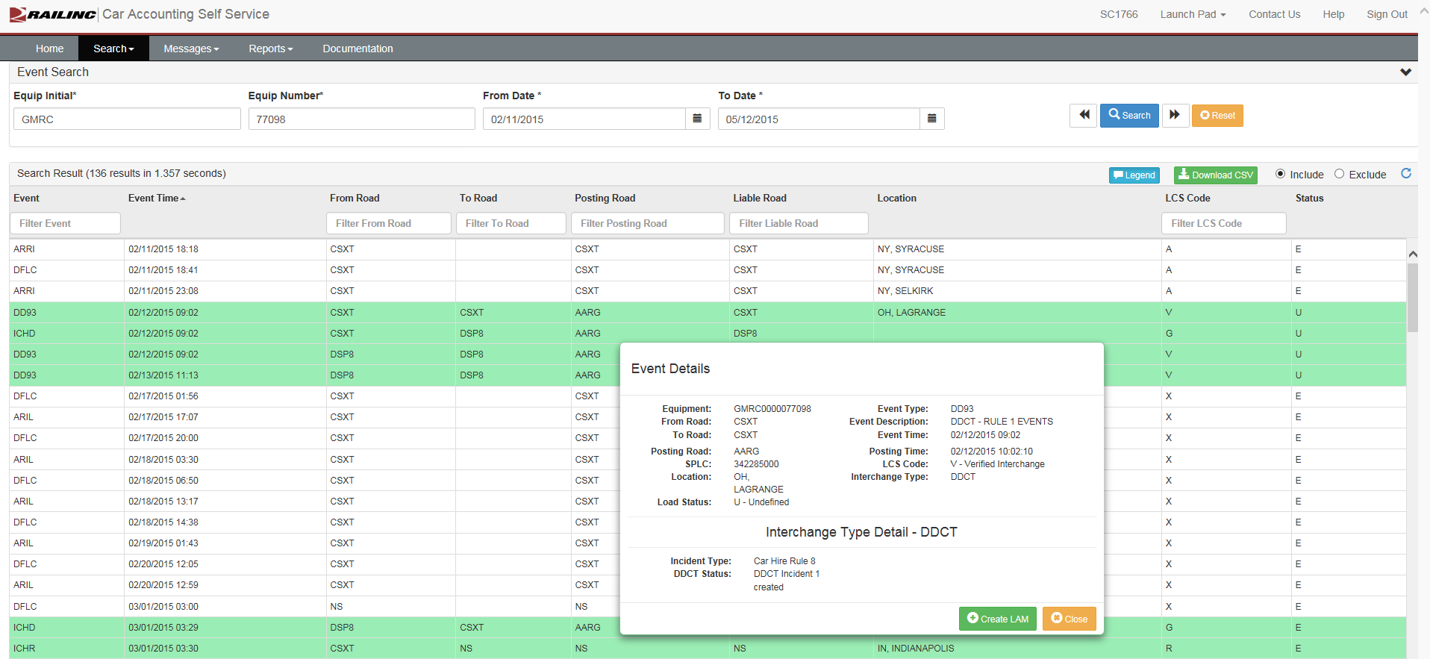
CASS OVERVIEW – DDCT / RULE 8

Slide 24
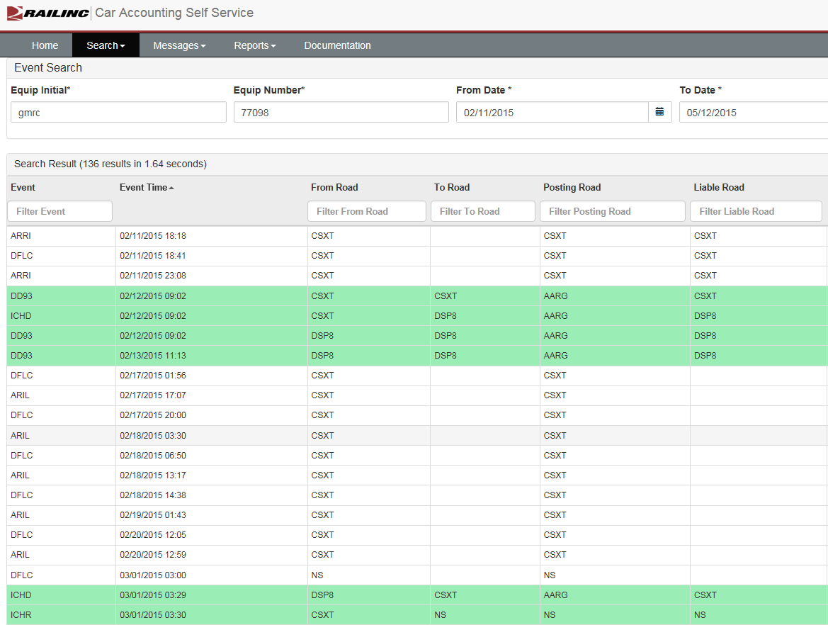
Cass overview – ddct / rule 8
2/12 – incident created
2/12 – disposition and depreciated value requested
2/13 – disposition and depreciated value provided

Slide 25
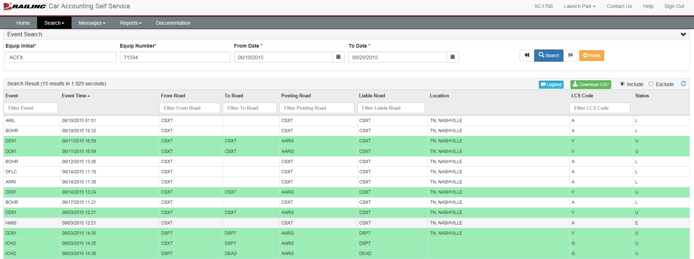
CASS OVERVIEW – DDCT / RULE 7

Slide 26
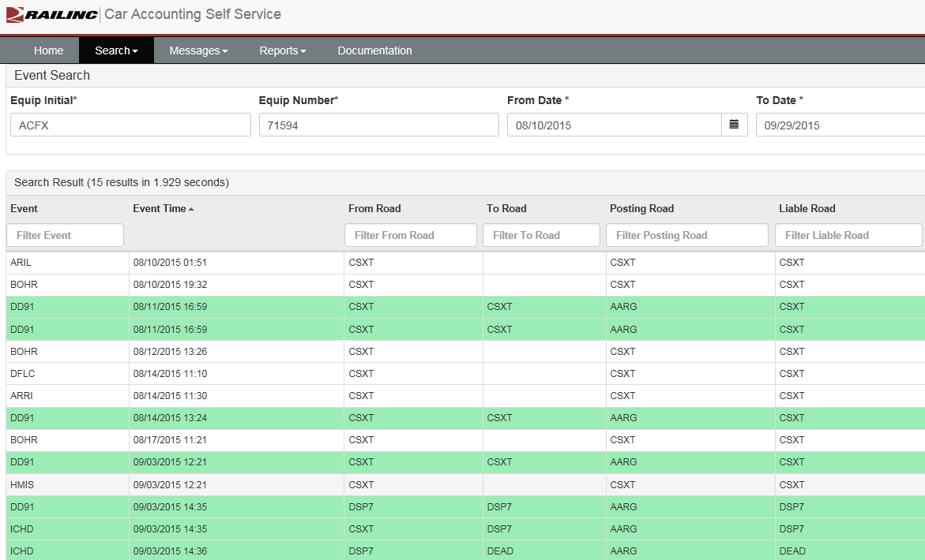
Cass overview – ddct / rule 7
8/11 – incident created
8/11 – disposition and depreciated value requested
8/14 – disposition and depreciated value provided
9/3 – damaging carrier offers settlement
9/3 – offer is accepted

Slide 27
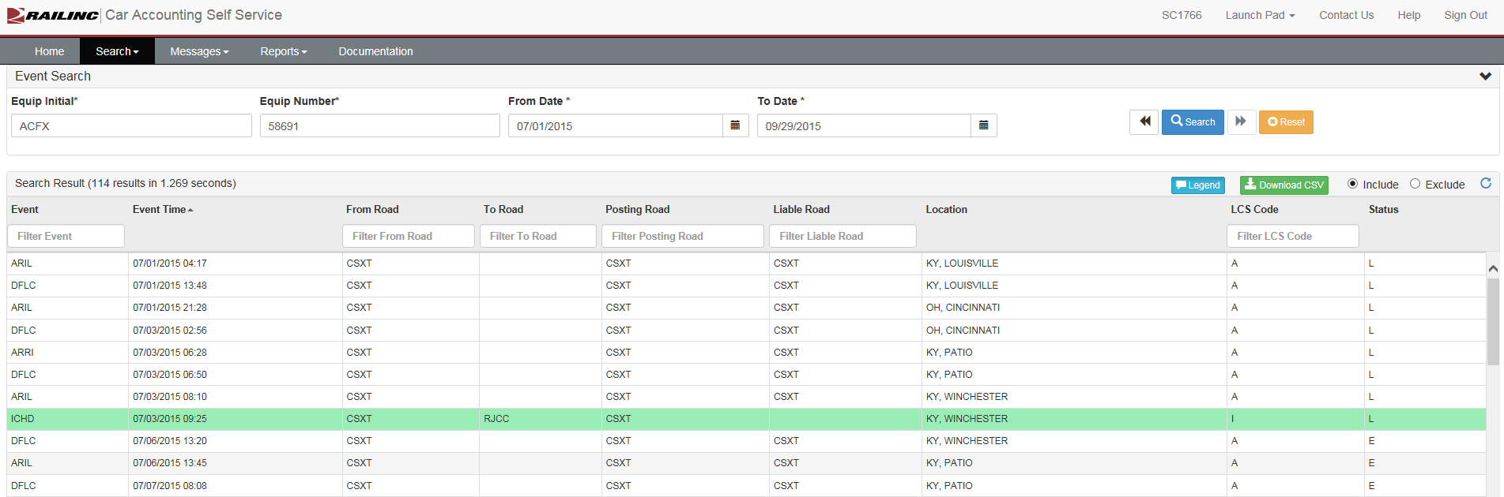
CASS OVERVIEW – ILLOGICAL INTERCHANGE

Slide 28
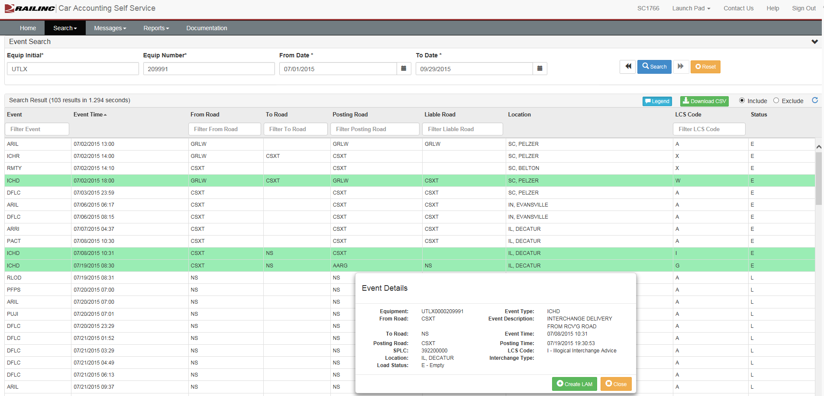
CASS OVERVIEW – ILLOGICAL INTERCHANGE / LATE REPORTING

Slide 29
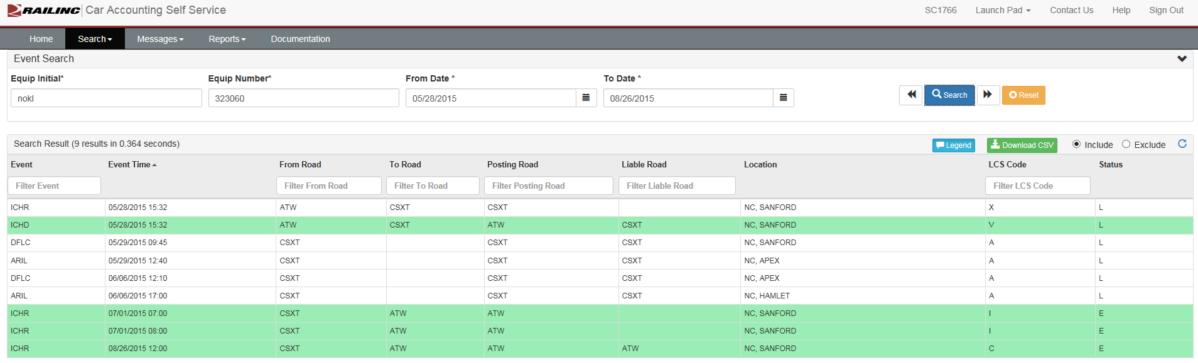
LIABILITY ACCEPTANCE MESSAGE (LAM)

Slide 30
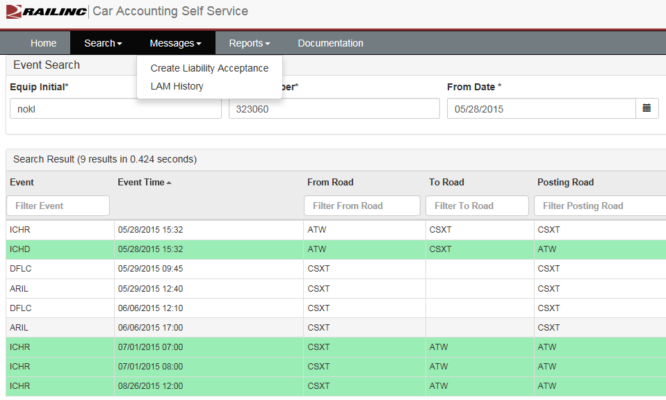
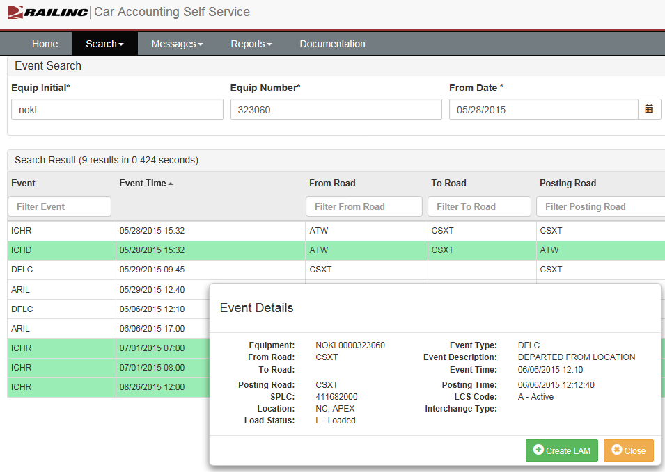
REPORTING A LAM

Slide 31
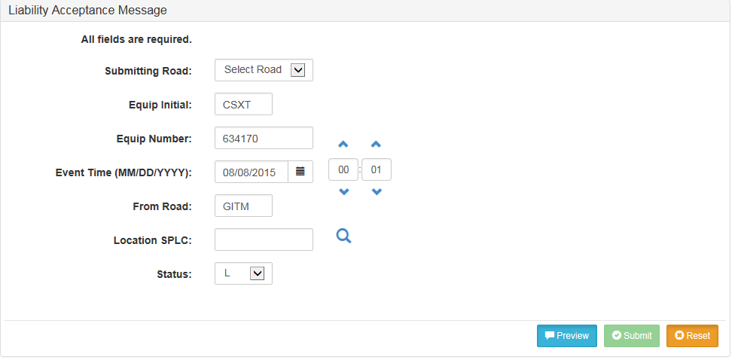
Reporting a lam
Allows carriers to accept liability without regard to LCS
Must be created by carrier receiving liability
Date within 120 hours

Slide 32
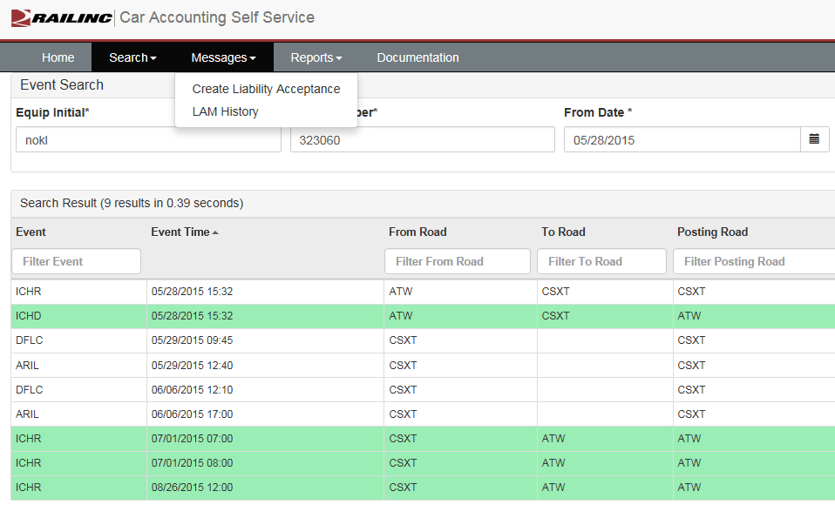
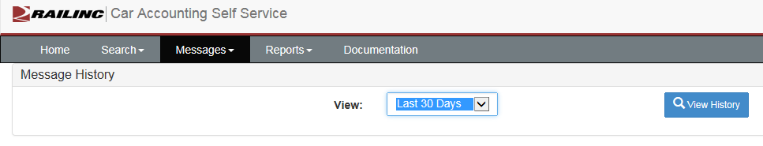
LAM History

Slide 33
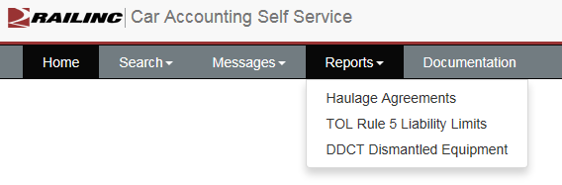
Cass reports

Slide 34
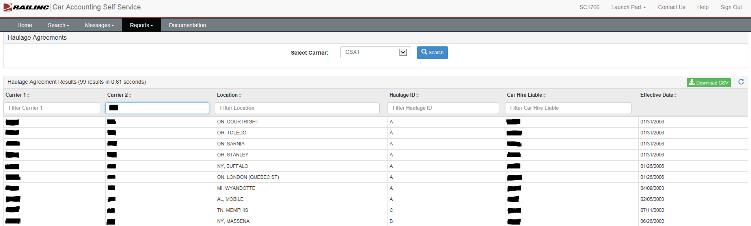
Cass reports – haulage agreements

Slide 35
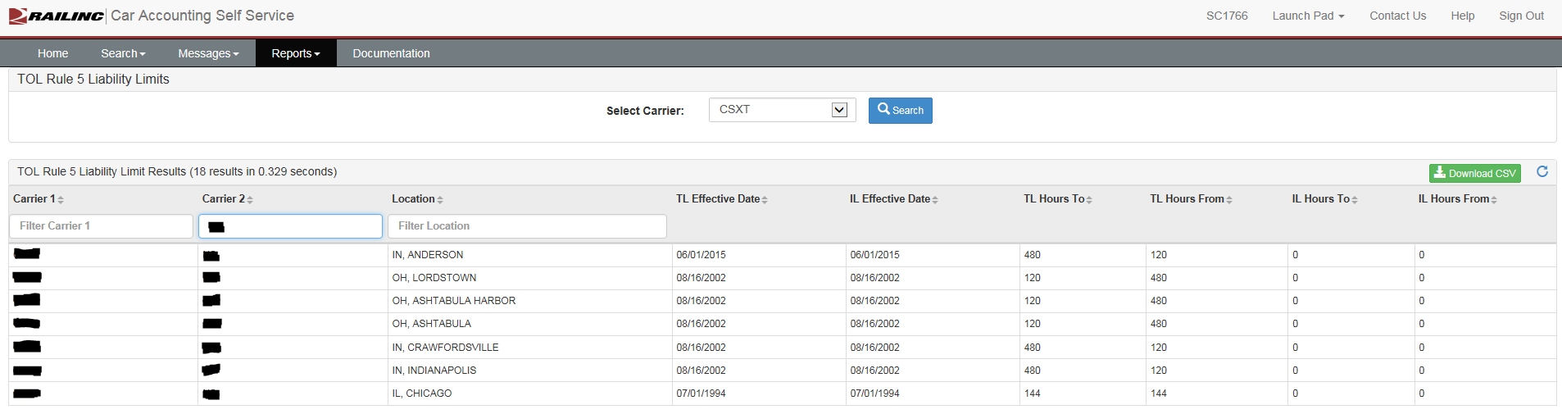
Cass reports – tol rule 5 liability limits

Slide 36
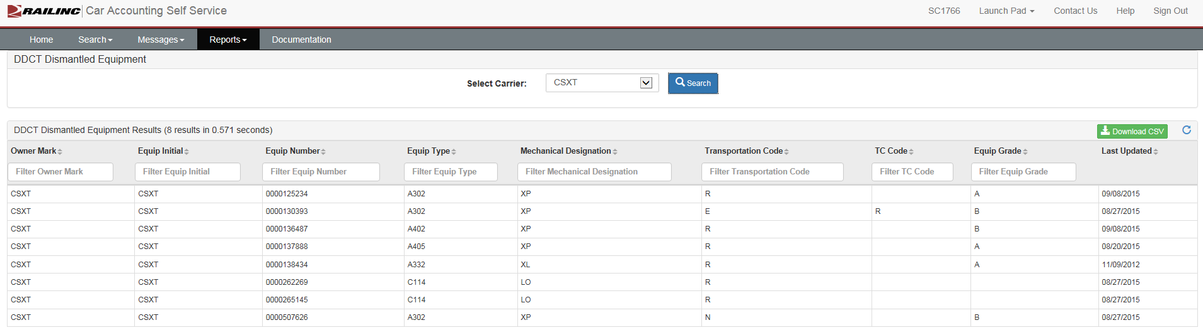
Cass reports – ddct dismantled equipment

Slide 37
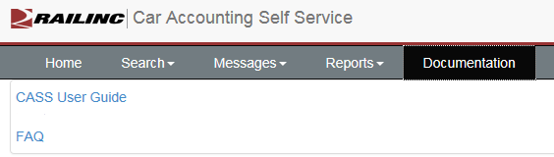
Cass documentation

Slide 38
FUTURE CASS ENHANCEMENTS
Rule 4 – enhanced logic to match waybills Nov 2015
Rule 4 – overlapping TOL into multiple months Nov 2015
Increasing event data from 2 to 3 years 2016 release
Enhancement of CASS event shading, Rule 4 and haulage, possible 2016 release
Questions or assistance - csc@railinc.com

Slide 39


