Slide 1

Help Wanted!
Tomorrow
September 14-16, 2008
Notes:
1

Slide 2
Where to start?
2

Slide 3
Transportation…
We’re
Here to
Help!
Tomorrow
September 14-16, 2008
Notes:
3

Slide 4
Can My Performance
Effect Car Hire?
Tomorrow
September 14-16, 2008
Notes:
4

Slide 5
My Job …
Move cars
2. Don’t move
cars
Tomorrow
September 14-16, 2008
Notes:
5

Slide 6
Survey said…
6

Slide 7
We get Car Hire relief…
when crew is annulled
yard/terminal derailment
place/pull error
industry switching schedule
locomotive issues
7

Slide 8
We get Car Hire relief…
crew outlawed
holidays
weekends
only applies to loads
XXXX’s don’t count
8

Slide 9
Are there rules?
Just one….
Your must change your…
Behavior
9

Slide 10
Change
Behavior
10

Slide 11
Influence
Environment
11

Slide 12
Change by…
basic communication
training levels
performance feedback
buy and sell
12

Slide 13
What has changed?
Right-Sizing Switching Crews
Rescheduled Customer Switching
Operating Rules
Tomorrow
September 14-16, 2008
Notes:
13

Slide 14
What has changed?
Right-sizing Switching Crews
  Education/Training
  Communication
    Awareness
    Paperwork completion
Tomorrow
September 14-16, 2008
Notes:
14

Slide 15
What has changed?
Reschedule Customer Switching
  Bi/Tri Weakly Service
  Perspective Loading
    Car Supply
  Education/Training
  Communication
Tomorrow
September 14-16, 2008
Notes:
15

Slide 16
What has changed?
We have a proven plan!
Tomorrow
Mty/Ld
Cars
Crew & Schedule
The Plan
Dock to Dock
Power
September 14-16, 2008
Notes:
16

Slide 17
Reporting Events:
Tue 09/01 0800 - Interchange Received (Empty)
Tue 09/01 2130 - Car Humped
Tue 09/01 2131 - Car Constructively Placed
Wed 09/02 1510 - Customer Ordered Car For Placement
Fri 09/04 1030 - Car Placed
Wed 09/09 1445 - Car Released Loaded
Thu 09/10 1115 - Car Pulled From Customer
Fri 09/11 1850 - Car Humped
Sat 09/12 1515 - Car Set To O/B Track
Sun 09/13 0520 - Foreign Road Annuls O/B Crew
Sun 09/13 0610 - Rule 15 Generated to Foreign Road
Tue 09/15 0750 - Interchanged Delivery (Load)
Tomorrow
September 14-16, 2008
Notes:
17

Slide 18
What’s Happ’n?
Tue 09/01 0800 – Interchange
Received (Empty)
Wed 09/02
Thu 09/03
Fri 09/04
(Placement)
Tomorrow
?
Bunches of
Transportation
and
Customer Stuff
September 14-16, 2008
Notes:
18

Slide 19
What’s Happ’n?
Tue 09/01 0800 – ICHR Empty
Wed 09/02
Thu 09/03
Fri 09/04
Sat 09/05
Sun 09/06
Mon 09/07
Tue 09/08
Wed 09/09
Thu 09/10
Tomorrow
Bunches of
Transportation
and
Customer Stuff
Not
Happ’n
September 14-16, 2008
Notes:
19

Slide 20
Reporting Events: (Replay)
Tue 09/01 0800 - Interchange Received (Empty)
Tue 09/01 2130 - Car Humped
Tue 09/01 2131 - Car Constructively Placed
Wed 09/02 1510 - Customer Ordered Car For Placement
Fri 09/04 1030 - Car Placed
Wed 09/09 1445 - Car Released Loaded
Thu 09/10 1115 - Car Pulled From Customer
Fri 09/11 1850 - Car Humped
Sat 09/12 1515 - Car Set To O/B Track
Sun 09/13 0520 - Foreign Road Annuls O/B Crew
Sun 09/13 0610 - Rule 15 Generated to Foreign Road
Tue 09/15 0750 - Interchanged Delivery (Load)
Tomorrow
September 14-16, 2008
Notes:
20

Slide 21
What’s Happ’n?
Thu 09/10
Fri 09/11
Sat 09/12
Sun 09/13
Mon 09/14
Tue 09/15
Tomorrow
Inbound Empty Received For Outbound Loading
TOL Hours Calculated Back From Actual Interchange Delivered Date and Time
TOL
120
Hours
September 14-16, 2008
Notes:
21

Slide 22
What’s Happ’n?
Thu 09/10
Fri 09/11
Sat 09/12
Sun 09/13
Mon 09/14
Tue 09/15
Tomorrow
Bunches of
Transportation
Stuff Not
Happ’n
TOL
120
Hours
September 14-16, 2008
Notes:
22

Slide 23
What’s Happ’n?
Tue 09/01 0800 – ICHR Empty
Wed 09/02
Thu 09/03
Fri 09/04
Sat 09/05
Sun 09/06
Mon 09/07
Tue 09/08
Wed 09/09
Thu 09/10
Tomorrow
$1.19 Per Hour Car Hire
24 Hrs X $1.19 = $ 28.56
216 Hrs X $1.19 = $257.04
Total Cars 3 X $257.04 =
$771.12
September 14-16, 2008
Notes:
23

Slide 24
What Changed?
Whose Under The Bus?
Tomorrow
Communication Failure
  Trainmaster/Crew
  Customer BOL
  Yardmasters
  Manager of the Plan
$771.12Car Hire
Terminal Dwell
Busted Plan
Sad Shipper
Dock To Dock
September 14-16, 2008
Notes:
24

Slide 25
What has changed?
Re-tool the Plan!
Tomorrow
Communication
  Customer
  Superintendant
  Trainmasters
  Train Crew
  Monitor Results
Empty
Cars
Crew & Schedule
The Plan
Dock to Dock
Power
September 14-16, 2008
Notes:
25

Slide 26
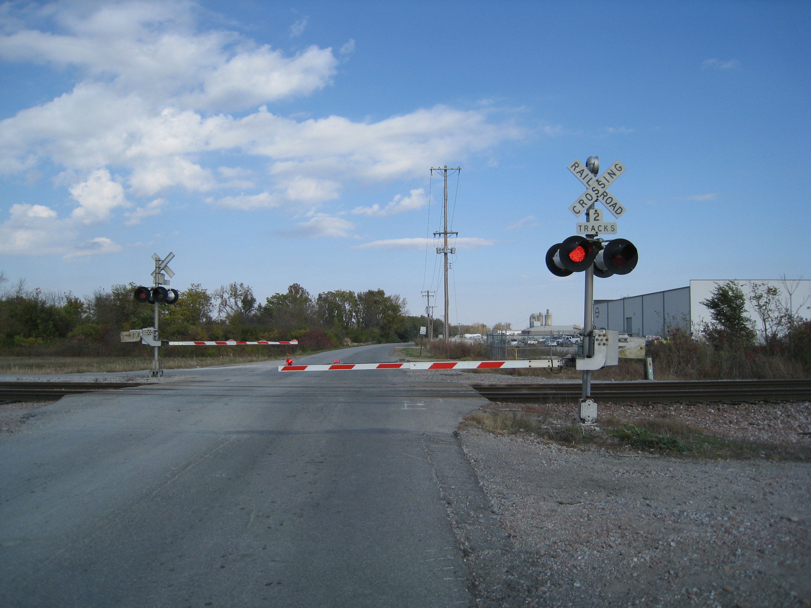

Slide 27
What Did You Just See?
27

Slide 29
…”THANK YOU,
Thank you very much!”
29

